Slide 1
NGSI Context Interfaces and Semantics
Martin Bauer
NEC Laboratories Europe

Slide 2
Overview
Semantic Modelling and Ontologies
Ontologies for NGSI Context Data Model
NGSI-10 Data Format as Container for Ontology Instances

Slide 3
Semantic Modelling and Ontologies
Ontology (Wikipedia): In computer science and information science, an ontology is a formal naming and definition of the types, properties, and interrelationships of the entities that really or fundamentally exist for a particular domain of discourse.
Ontology:
vocabulary with a structure, i.e. defines concepts, properties and relationships
capture a shared understanding of a domain of interest
provide a formal and machine manipulable model of the domain

Slide 4
Ontology Concepts, Relationships, Properties
Concepts do not identify individuals but they identify classes of individuals. Therefore, in the OWL standard ontology language from the World Wide Web Consortium (W3C), concepts are called Classes.
The structure part of the ontology is introduced through agreed, well defined, relationships between its concepts. Such a relationship – in OWL called Object Property – links a subject concept to an object concept.
subject concept → relationship → object concept
OWL:
domain Class → Object Property → range Class
Example:
Room → hasIndoorTemperature → Temperature
A second type of Properties in OWL is called Data Properties. A Data Property is linking a subject Class to a data. These data may be typed or untyped.
Example:
Temperature → hasValue → 36.5

Slide 5
Ontologies for NGSI Context Data Model
Why use ontologies in NGSI?
Agree on common vocabulary (entity & attribute types)
Agree on structure (e.g. which attributes can an entity of a certain type have)
Use of subtype matching (e.g. if requesting super type, you also get subtype)
Enable applications to make use of semantic descriptions, e.g. for analytics

Slide 6
Use of Ontology References in NGSI Data Model
NGSI Context Management, Approved Version 1.0 – 29 May 2012, OMA
C.1 Guidelines for defining Context Entity types and ids
An entity type can be a OMNA registered namespace (URN), an existing standard namespace or a proprietary namespace. Similarly, any proprietary or standard ontology reference (URL) can be used as entity type.
C.2 Guidelines for defining context attributes and domains
The definition of an attribute consists in the definition of the attribute name, the attribute type and the format of the attribute value. It may also define some specific associated metadata.
The definition of an attribute type or attribute name can occur by registering a namespace (URN) with OMNA, by reusing an existing standard namespace or by using a proprietary namespace or name. Similarly, any proprietary or standard ontology reference (URL) can be used to define a new attribute type or attribute name.

Slide 7
NGSI-10 Data Format
EntityId
ID
urn:x-iot:smartsantander:1:2
Type
light
isPattern
false
AttributeDomain
ContextAttribute
Name
light
Type
float
ContextValue
0.59
Metadata
unit
Name
Type
String
Value
lux
Domain Metadata
Name
Type
Value

Slide 8
NGSI-10 Data Format – Container for Ontology Instance
EntityId
ID
urn:x-iot:smartsantander:1:2
Type
http://www.semanticweb.org/neclab/smartsantander/NGSI#LightSensor
isPattern
false
AttributeDomain
ContextAttribute
Name
http://www.semanticweb.org/neclab/smartsantander/NGSI#hasLight
Type
http://www.semanticweb.org/neclab/smartsantander/NGSI#Light
ContextValue
0.59
Metadata
Name
http://.../NGSI#hasMetadataUnit
Type
http://.../NGSI#MetadataUnit
Value
lux
Domain Metadata
Name
Type
Value

Slide 9
Example: Using Ontology for Driving SantanderData to NGSI Conversion
Developed for oneM2M demo shown at oneM2M Showcase Event at ETSI in December 2014
Use Ontology + Convention (naming conforming to original names) for converting:
Find entity type in JSON tuples
Look-up entity type in Ontology
Check what attributes an entity of this type can have
Extract attributes values based on attribute names
Create NGSI structure

Slide 10
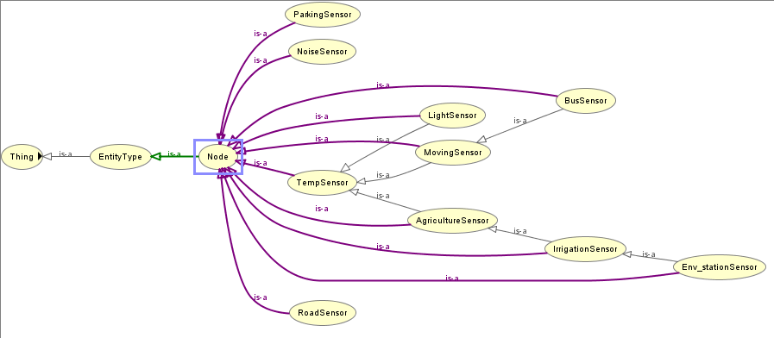
Entity Type Hierarchy

Slide 11
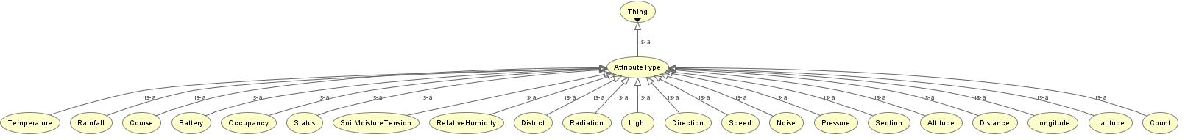
Context Attribute Type

Slide 12
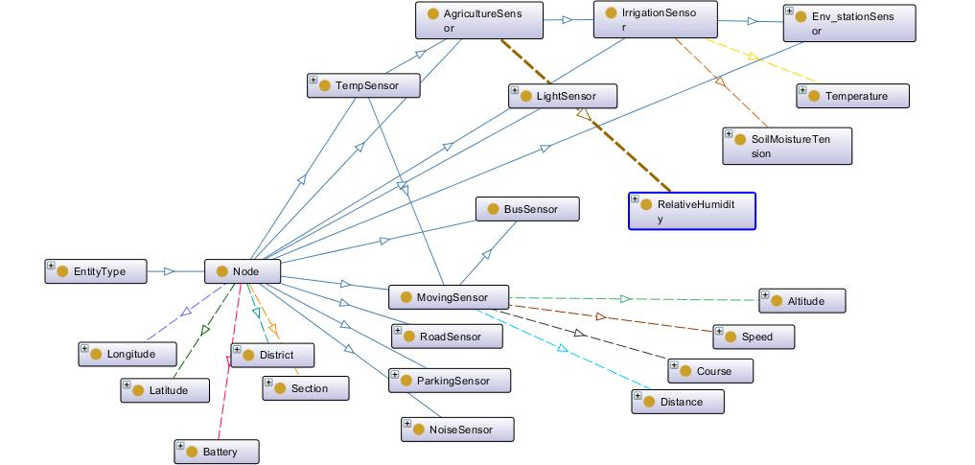
Ontology Example (incl. Object Property Examples)
hasGroundTemperature
hasTemperature
Entity Types
Context Attribute - Types

Slide 13
NGSI Information as Ontology Instance
Sensor
Light Sensor
rdfs:subClassOf
Meta Data Unit
Light
rdf:type
rdf:type
rdf:type
LightInstance
urn:x-iot:smart santander:1:2
MetaData Instance
santander:hasLight
santander:hasMetadataUnit
santander:hasLightValue
0.59
lux

